Slide 1

Machine Learning
ICT-
By-
Dr. Jesmin Akhter
Professor
Institute of Information Technology
Jahangirnagar University

Slide 2
Contents
The course will mainly cover the following topics:
Ensemble Learning
Unsupervised Learning
Clustering Fundamentals
Hierarchical Clustering
………………………..
Neural Networks and Deep Learning
Notes:
More Supervised - Adaboost Gradient boosting Xgboost

Slide 3
Exam schedule
Tutorial | Date and Time
Tutorial-01 | After 3 classes
Tutorial-02 | After 6 classes
Tutorial-03 | After 9 classes
NB: Schedule may change

Slide 4
Outline
Ensemble Learning
Notes:
https://iq.opengenus.org/cart-algorithm/

Slide 5
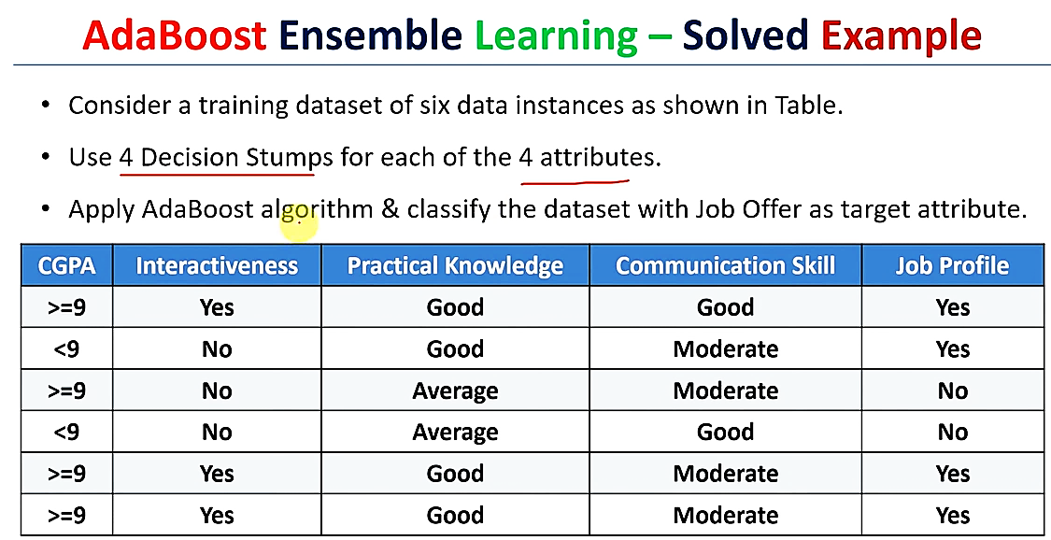

Slide 6
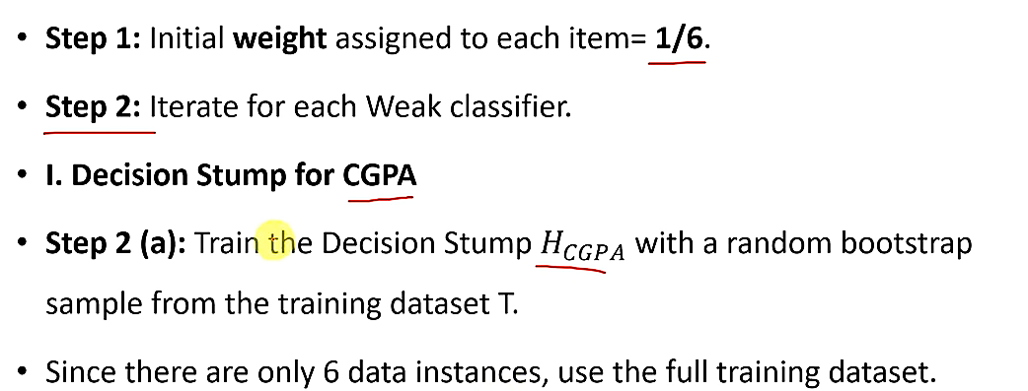

Slide 7
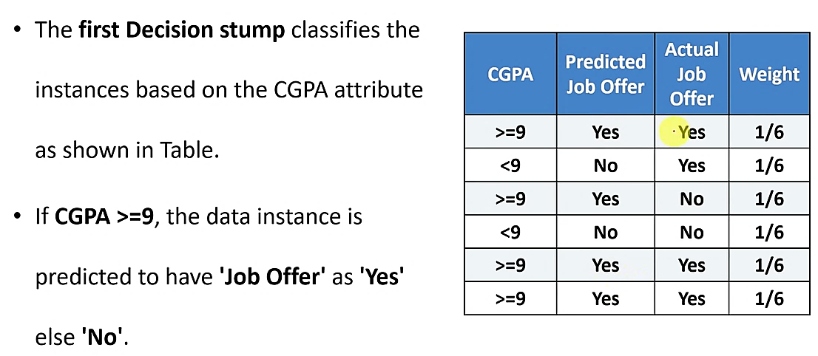

Slide 8
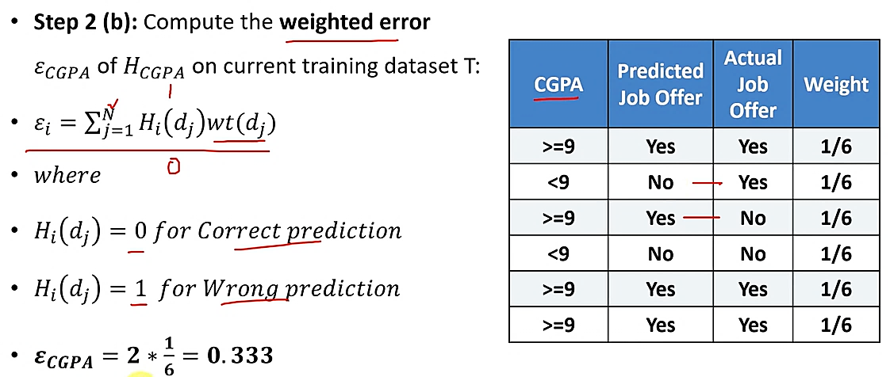

Slide 9
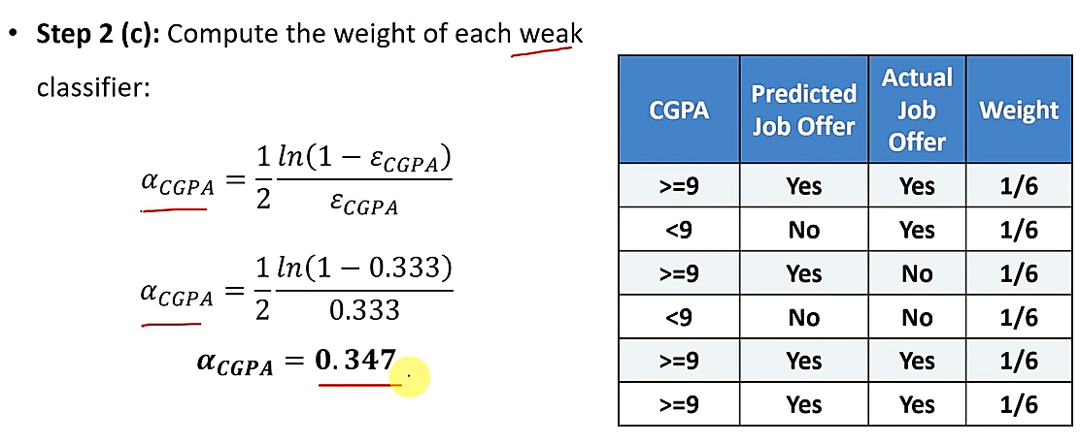

Slide 10
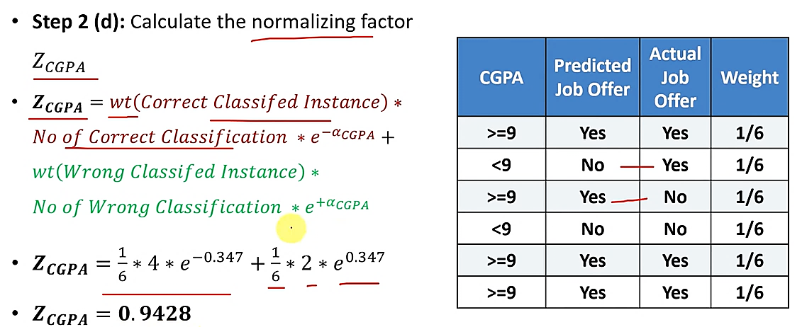

Slide 11
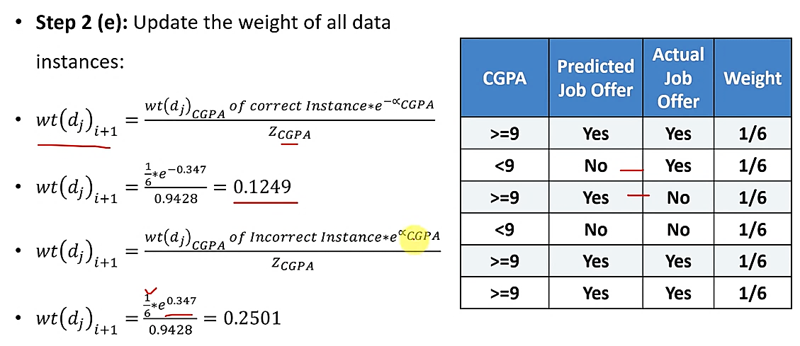

Slide 12
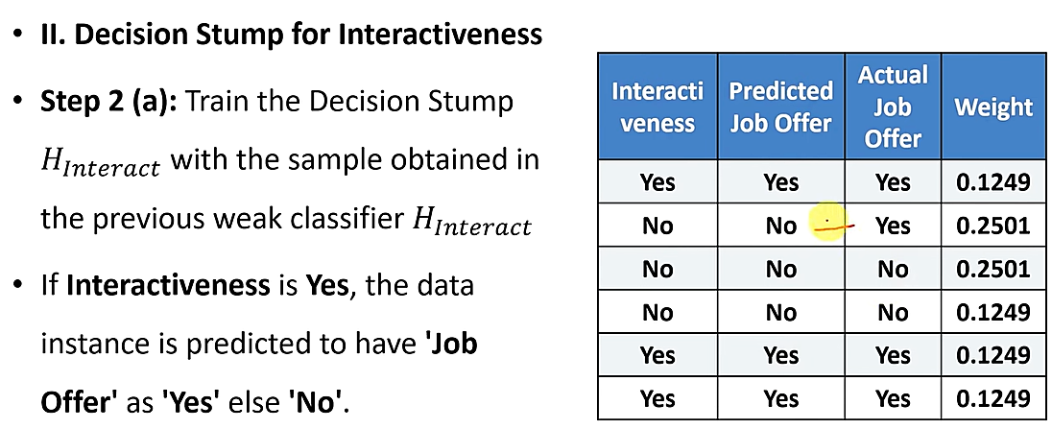

Slide 13
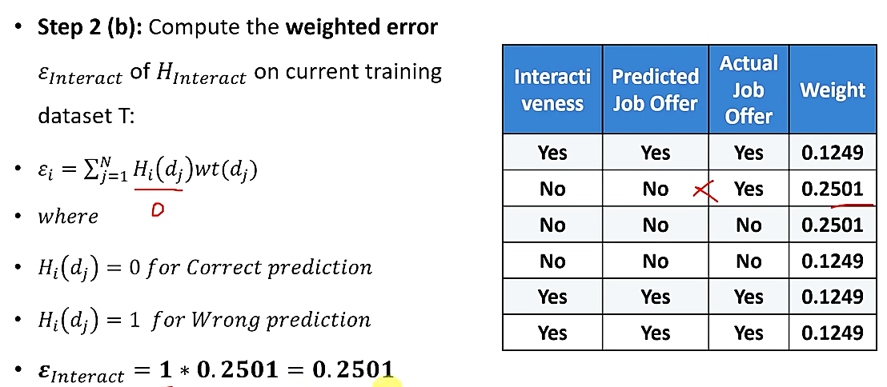

Slide 14
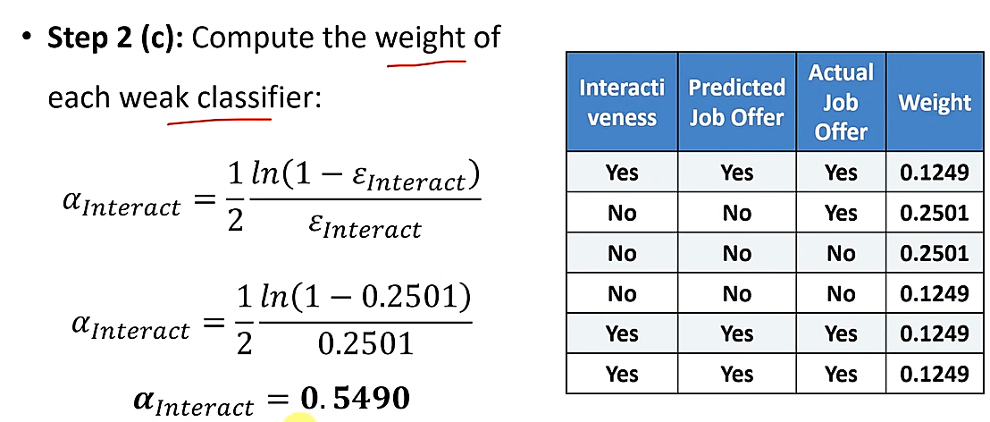

Slide 15
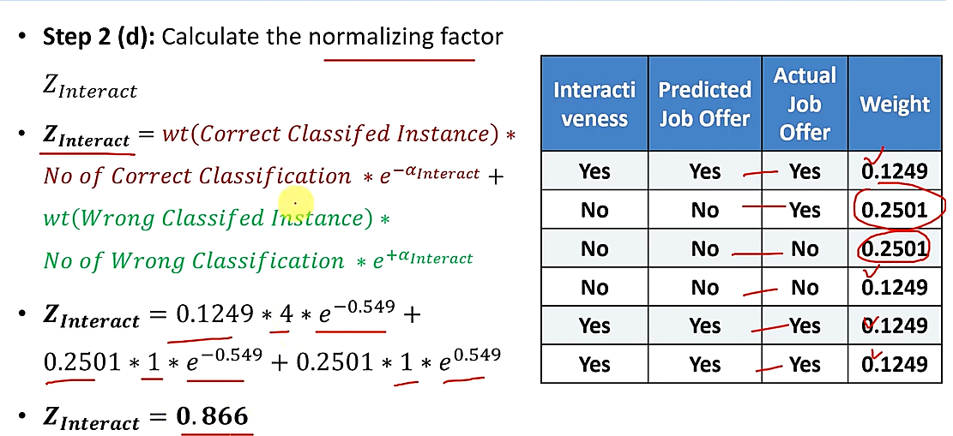

Slide 16
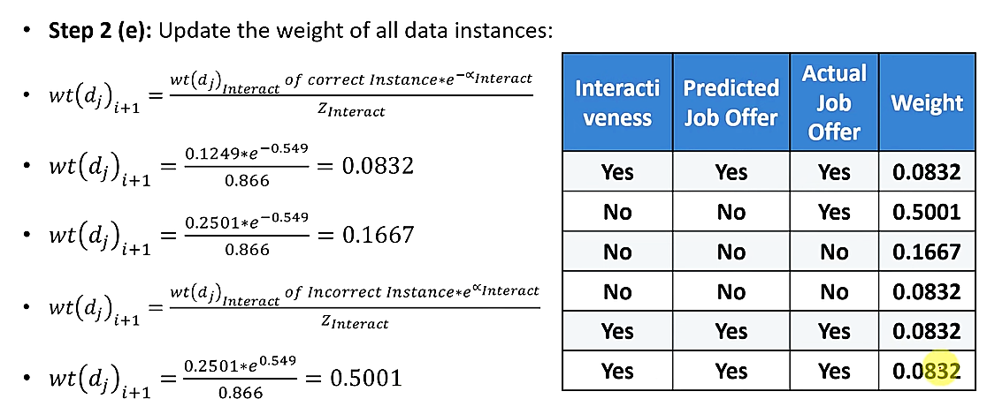

Slide 17
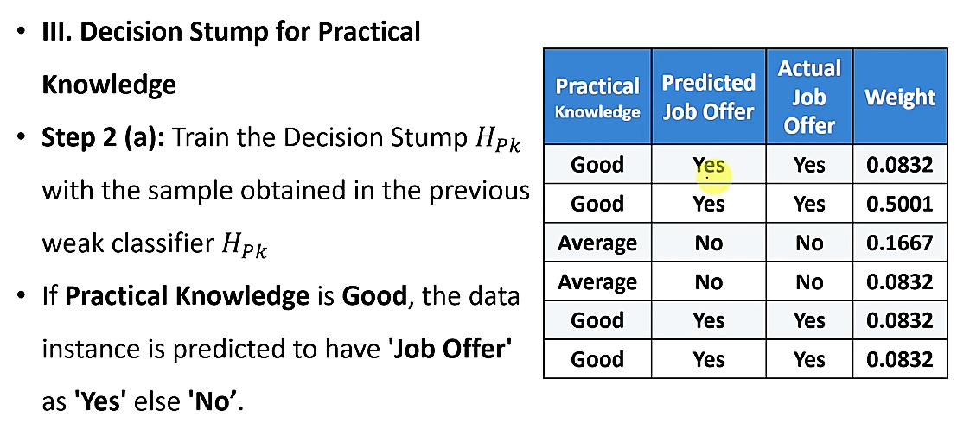

Slide 18
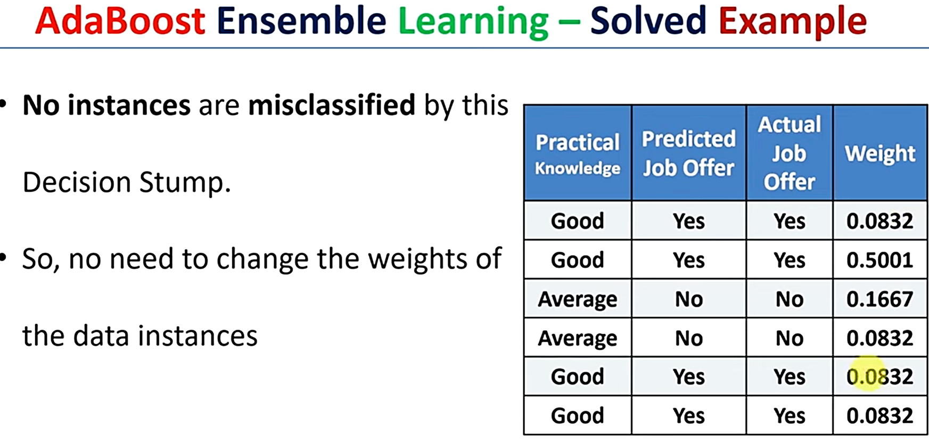

Slide 19
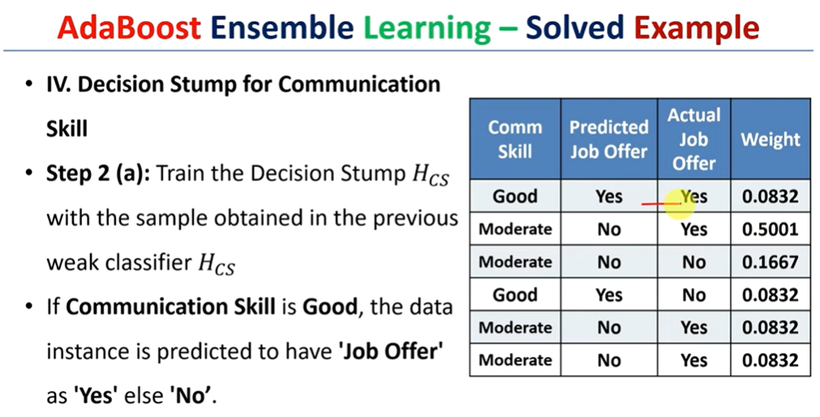

Slide 20
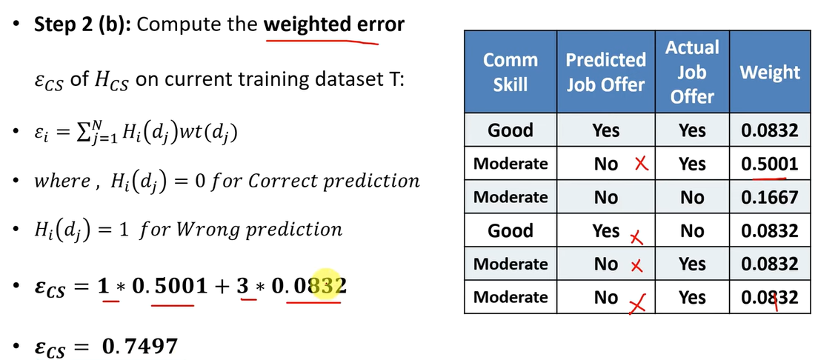

Slide 21
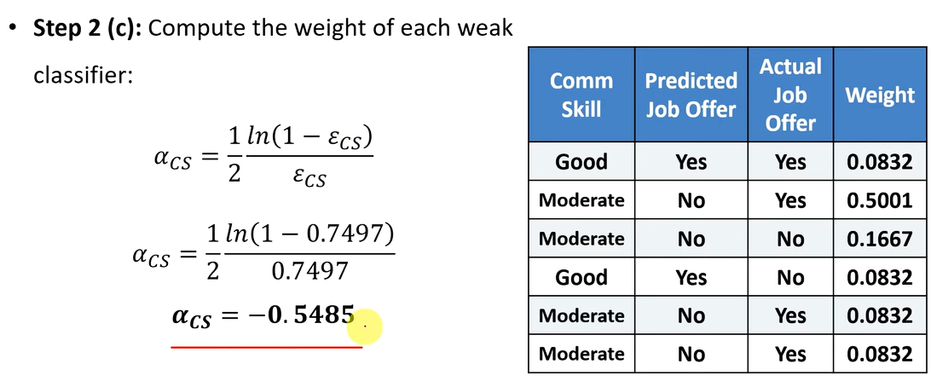

Slide 22
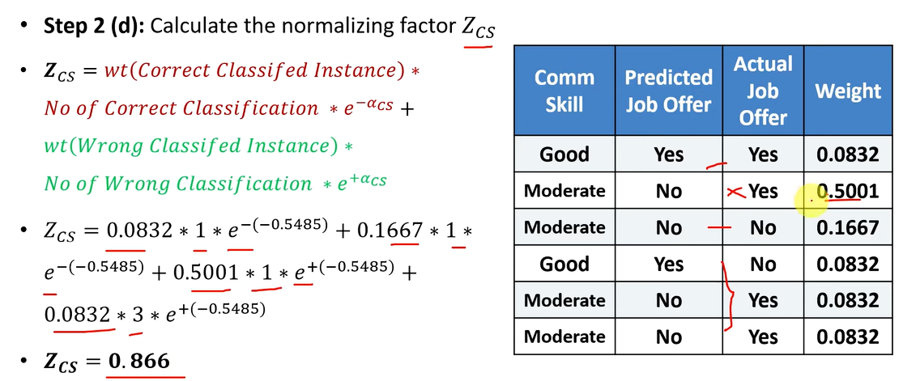

Slide 23
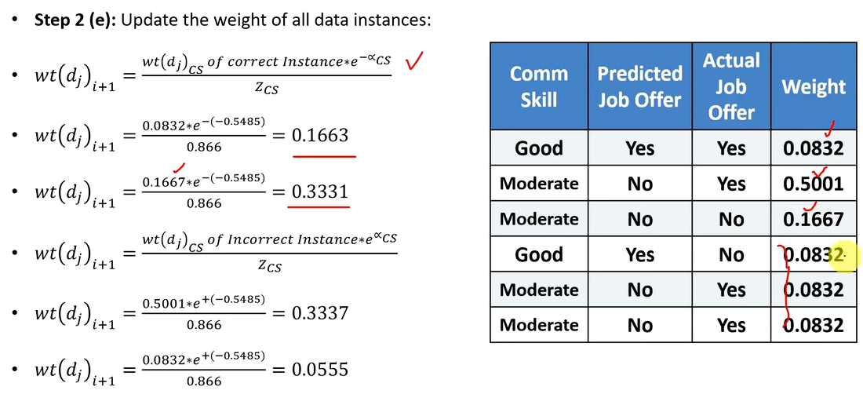

Slide 24
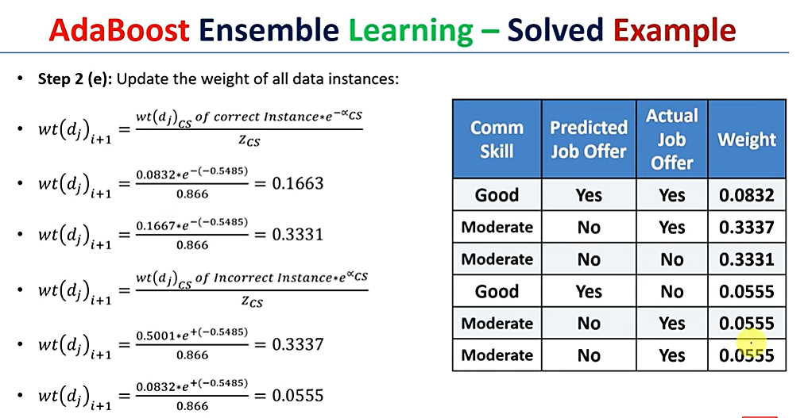
0.1663

Slide 25
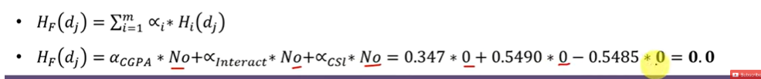
Weighted Average

Slide 26
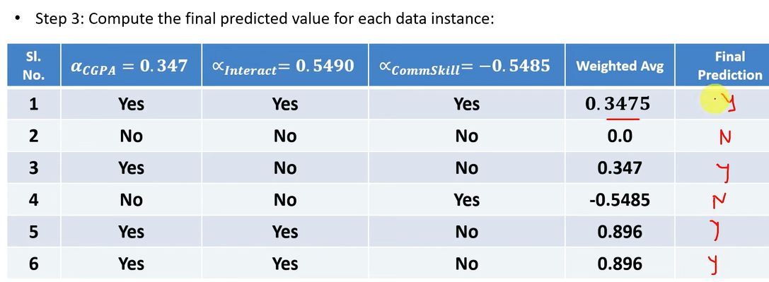

Slide 27
Thank You

